Slide 1

Characterization of Lysine on the Surface of SiO₂ Nanoparticles
Tom Osborn Popp
Arizona State University
Mentor: Jeff Yarger

Slide 2
Introduction
Nanotechnology is an exciting field with applications in science, medicine, engineering and everyday life.
The field of nanomaterials is focused on development and manipulation of matter in the 1-100nm scale.
At the nano scale, quantum effects and surface interactions become very important

Slide 3
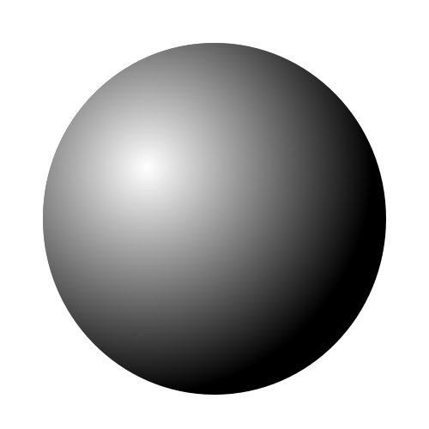
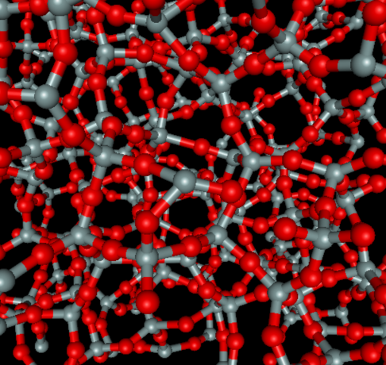
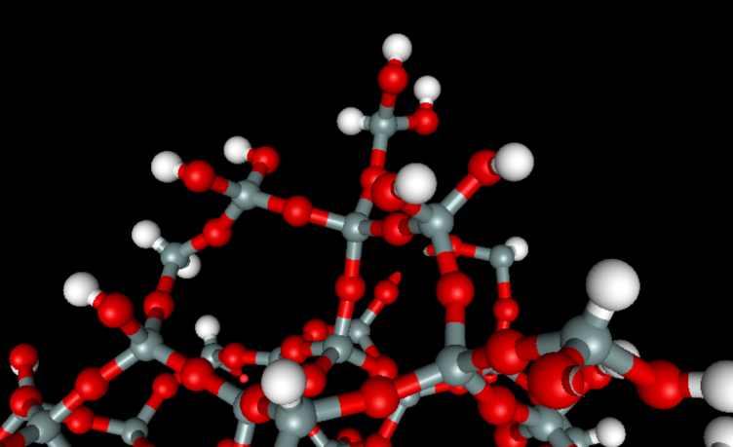
Bulk
Nanoscale
Properties governed by surface interactions

Slide 4
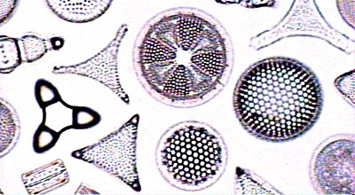
Motivations for the Study
How do molecules adsorb to silica surfaces? What functional groups play key roles in the adsorption process?
Nanoscale silica is a major subject of research in developments for drug delivery—silica is biocompatible. Drug adsorption to silica for controlled release.
Intricate silica structures made by diatoms
Photo by Dr. Karen Wetmore

Slide 5
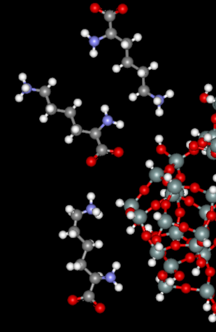
Goals of the Study
How does the amino acid lysine adsorb to the surface of silica?
In what orientation and with which functional groups does lysine preferentially adsorb to the surface?
Use Raman spectroscopy and both solution-state and solid- state NMR spectroscopy

Slide 6
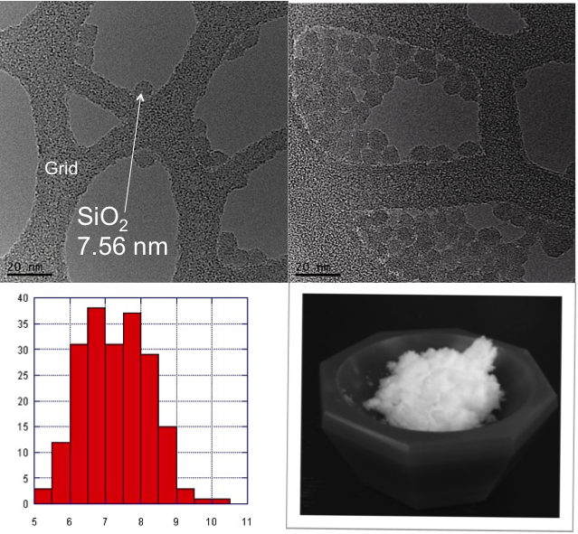
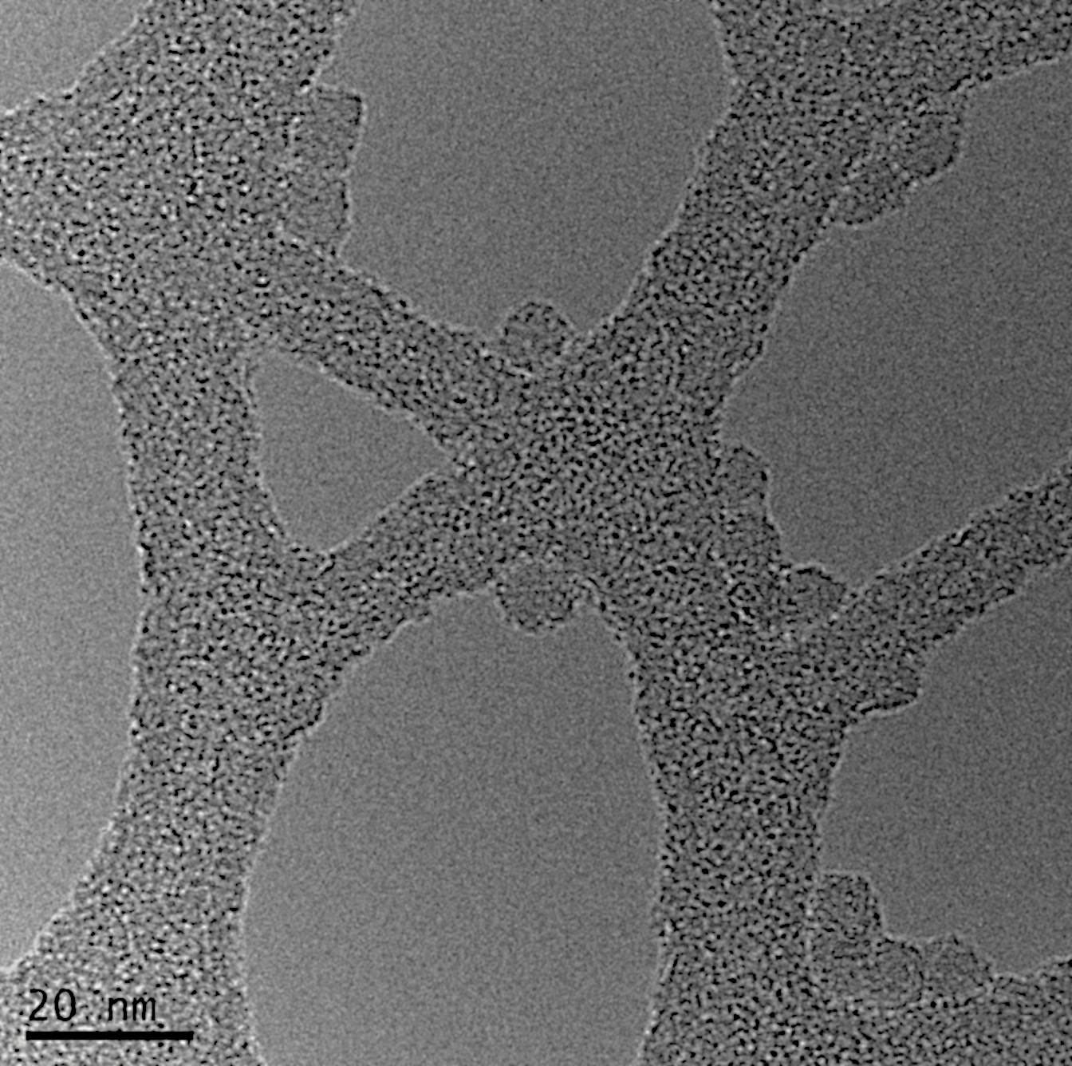
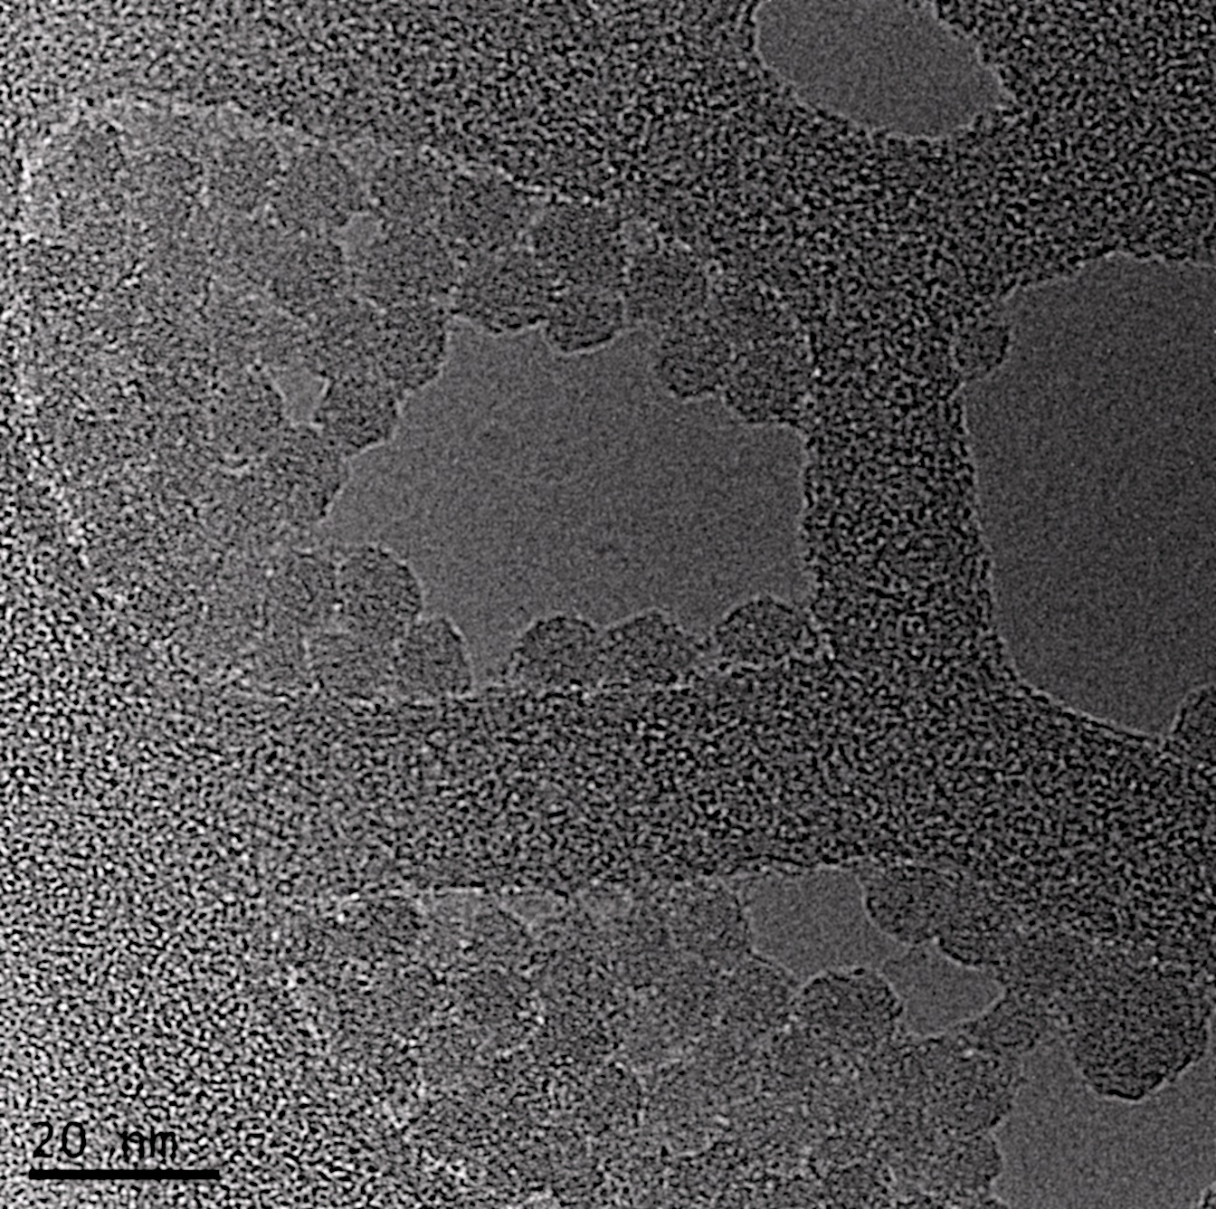
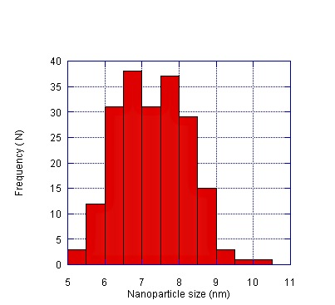
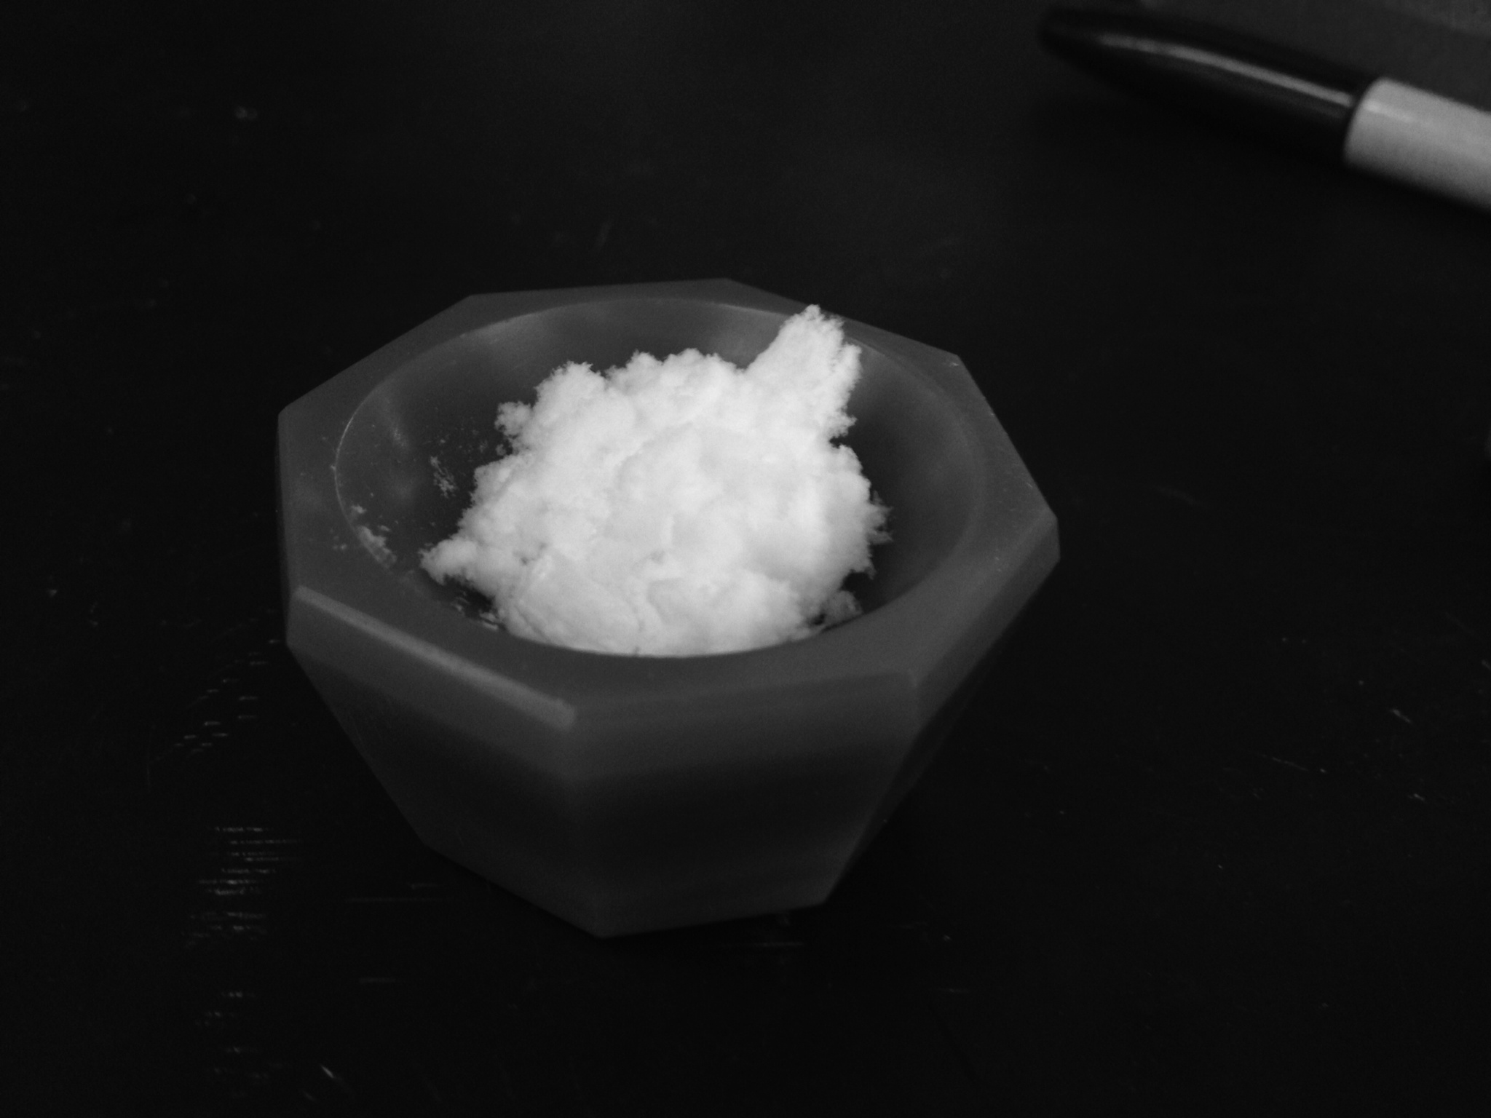
SiO₂ Nanoparticles
Made by heating a solution of lysine in water mixed with solid silicon powder in suspension.
Freeze-dry solution to obtain solid product
TEM imaging shows average diameter of 7.56 nm
Grid
Grid
Grid
SiO₂
7.56 nm
SiO₂
7.56 nm
SiO₂
7.56 nm

Slide 7
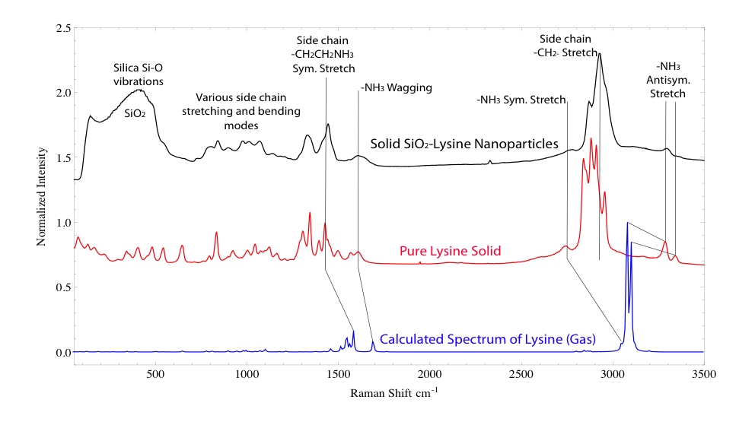
Raman Spectroscopy

Slide 8
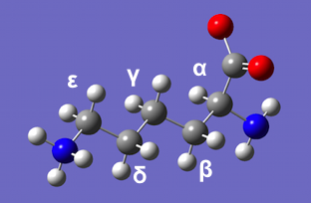
¹³C Solid State CP-MAS NMR
Lysine adsorbed to SiO₂-NP’s
Lysine

Slide 9
¹H Solution State NMR
Lysine adsorbed to SiO₂-NP’s
Lysine

Slide 10
Conclusions and Future Directions
In the solid state, lysine adsorbs via the side chain amine, possibly also at the alpha-amine.
In solution state, adsorption via the side chain amine.
To support these results, future NMR studies looking at amine chemical shifts of ¹⁵N using ¹⁵N-labeled lysine, and temperature studies to see a possible temperature dependence of orientation in the solution state
Control with experimental conditions how lysine adsorbs to the silica surface

